Slide 1


Final defense by Victor AUBRY – aubry_g
May 16th – November 16th

Slide 2
Presentation’s content
Mobigame
Zombie Idle

Slide 3

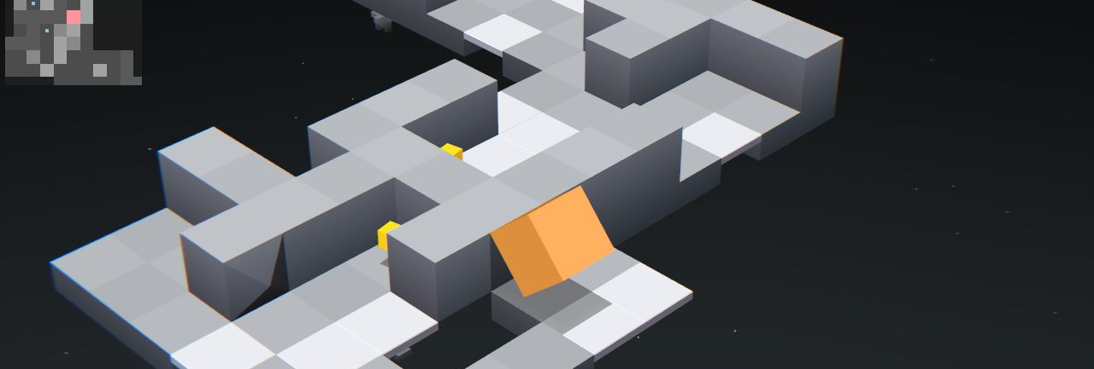
Mobigame
Founded in 2004 by David Papazian and Matthieu Malot
Creators of EDGE and Zombie Tsunami

Slide 4
Mobigame
16 employees
4 games in development

Slide 5
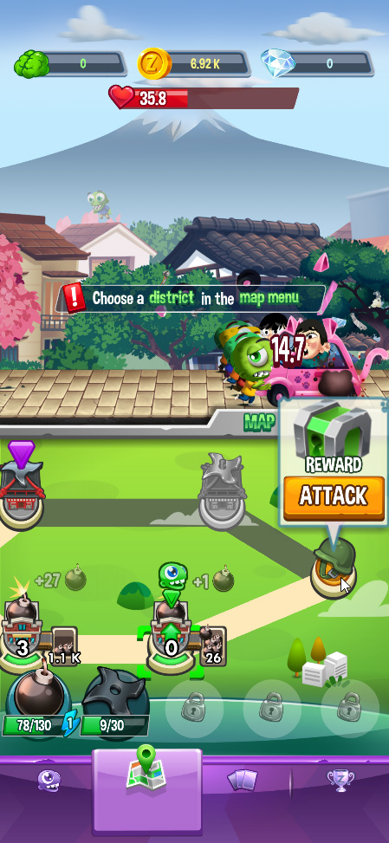
Zombie Idle
Grow a horde of zombies
Capture districts to gain powers
Reach the final boss of every maps
Drop cards to improve damage, production and more

Slide 6
Team
David Papazian
Founder
Victor Aubry
Developer
Véronique Dobarro
Artist
Maxime Kuppert
Artist
Bastien Berge
Developer
Pierre Der Kegorkyan
Producer & Game Designer

Slide 7
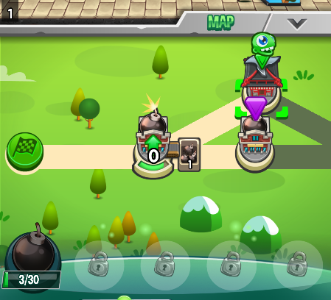
Map
Attack and capture districts
Collect resources
Upgrade districts

Slide 8
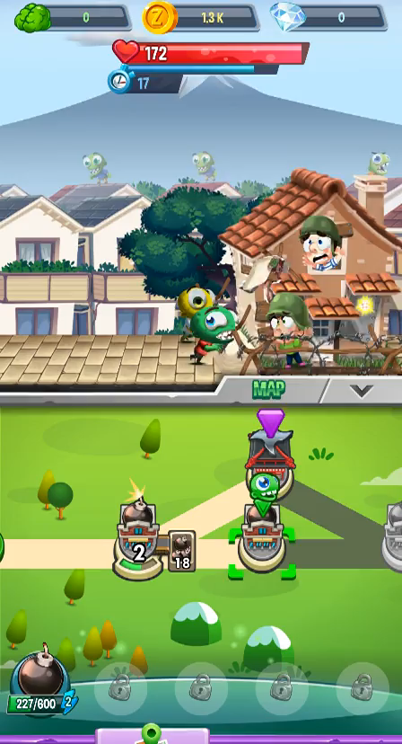
Powers
Shows unlocked powers
Use powers to deal more damages

Slide 9

Chests
Awarded when defeating a boss
Give cards

Slide 10
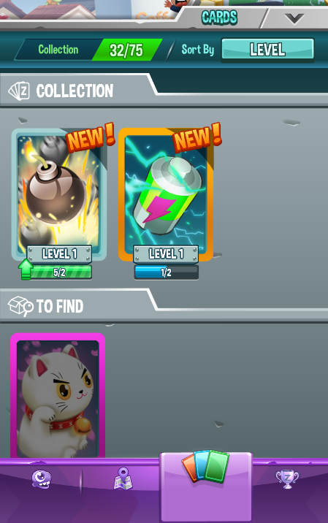
Card inventory
Obtained cards
Card information
Upgrade

Slide 11
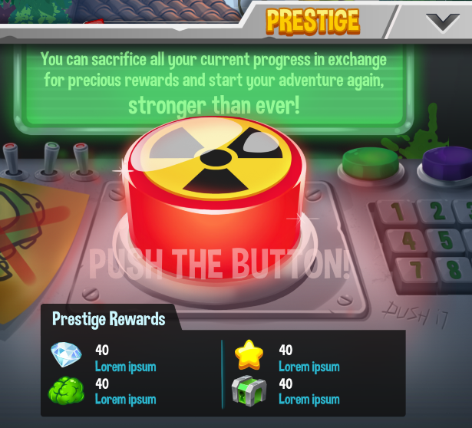
Prestige
Lose some progress (zombies, coins, powers)
Keep cards
New map

Slide 12
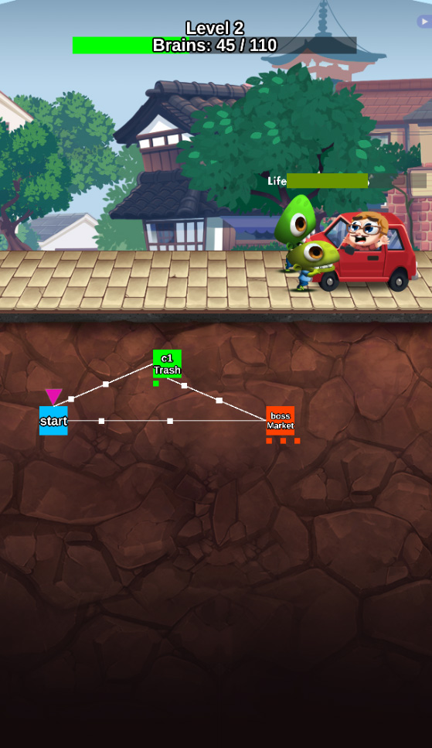
Evolution
May version
October version

Slide 13
Experience
C++
Video games
Team

Slide 14
Thank you
Questions ?

